Slide 1
Inventory Control
Description:
Analysis of deterministic and stochastic inventory models;
Lot size models and their extensions;
Reorder point determination,quantity discounts;
The Wagner-Whitin algorithm;
Newsvendor (single period and two period models);
Period review and Multi-echelon models.
Introduction
1- 1

Slide 2
Course Content
Introduction
Batch Quantities for Deterministic Demand
Time varying demand (Wagner-Whitin algorithm)
Decision & Forecast Horizons
Safety Stock and Reorder Points
Joint Optimization of Order Quantity and Reorder Point
Optimality of Base-Stock Policies
Optimality of (s,S) Policies
Power-of-Two Policies
Production Smoothing & Joint Replacement
Inventory Model with Markovian Demand
Forecasting
Implementation
Introduction
1- <number>

Slide 3
Introduction-I
Inventory everywhere:
my desk drawer
piles of coal in a Tokyo steel plant
supply room, retail stores
vast global network of industry
inventories in transit
inventories in the service industries
Introduction
1- <number>

Slide 4
Introduction-II
Customer do not easily forgive shortage of delivery delays
Inventory management critical to a firm’s strategic viability
Success stores in retailing (Wal-Mart), auto (Toyota), computer (Dell) are founded on operational capabilities that among other things keep inventories lean
Amazon.com
- operation without huge inventory
- innovation in inventory management enabled by technology
https://www.youtube.com/watch?v=IMPbKVb8y8s
https://www.youtube.com/watch?v=cAUXHJBB5CM
https://www.youtube.com/watch?v=zERrqLFotSY
--
Introduction
1- <number>

Slide 5
Importance of Inventories-I
Inventories present about 1/3 of our total investments, and as a result are extremely significant
The total amount of inventories in the U.S was $243.5 billion in 1970 and $1.1 trillion in March 1999; that is 1.35 times their total monthly sales
Following the inventory recession of 1920s, Dun and Bradstreet issued a book describing numerous cases of business failures resulting from inventories
Businessmen have developed an almost “pathological fear of increasing inventories.” (Whitin)
Introduction
1- <number>

Slide 6
Importance of Inventories-II
This fear has had the effect of reducing inventories in many firms to operating levels far below good inventory practice, which has lead to high operating costs.
“Don’t expect your management to relinquish its belief in inventory turnover overnight. Years of use has given this tool far more stature than it rightfully deserves.” (Evert Welch)
Product diversification has increased the number of parts to control; these number literally in tens and hundreds of thousands.
Introduction
1- <number>

Slide 7
Introduction to Inventory Control-I
Supply Chain Management:
control of the material flow from supplier to customers is a crucial problem
Total investment in inventories is ENORMOUS
Huge potential for improvement to cut cost, to gain competitive advantage
⇒ Importance of Inventory Management
Introduction
1- <number>

Slide 8
Introduction to Inventory Control-II
Balancing conflicting goals of Finance, Production and Marketing
Finance: keep stocks low to free up investment capital
Purchasing: order large batches to get volume discounts
Production: long production runs to avoid time-consuming setups and have a large raw material inventory to avoid production stoppages
Marketing: have high stock of finished goods to avoid stockouts
⇒ Inventory Models seek to find the best balance between these goals.
Introduction
1- <number>

Slide 9
KEY CLIENT CHALLENGES: LEAD TIME
How do we improve the accuracy of our inventory forecasting and projections to prevent delays as a result of inaccurate estimations?
How do we quickly detect and manage potential bottlenecks through supply chain mapping or process re-engineering?
How do we enhance communication and supply chain visibility for better tracking and faster detection of delays?
How can we effectively develop and maintain strong relationships with our suppliers for reduced lead times?
Is there room for process automation or digitization within our supply chain to minimize manual tasks and save time?
Introduction
1- <number>

Slide 10
KEY CLIENT CHALLENGES
By asking these questions and implementing appropriate strategies and solutions at every stage of the supply chain, mining companies can effectively reduce lead time and manage bottlenecks before they create knock-on effects.
Introduction
1- <number>

Slide 11
Lead Time
ENSURE SUFFICIENT LEAD TIMES THROUGH BETTER SUPPLY CHAIN PLANNING AND COMMUNICATION WITH SUPPLIERS
Introduction
1- <number>

Slide 12
KEY CLIENT CHALLENGES
Procurement
How do we negotiate better pricing and terms with our suppliers?
How do we leverage technology such as robotics process automation (RPA) to streamline our procurement process and select suitable technology vendors?
What are the methodologies, data analytics or forecasting tools we can use to optimize our procurement demand planning?
How do we enhance the sustainability of our procurement process to adhere to evolving regulations?
How can we optimize the compliance monitoring and due diligence process to avoid legal consequences?
Introduction
1- <number>

Slide 13
With proactive planning, effective risk management strategies, leveraging the right technology, and continuous monitoring of market conditions, procurement professionals in the mining industry can ensure successful operations.
Introduction
1- <number>

Slide 14
Inventory Management: Set up inventory control methods to hedge against unforeseen supply disruption
How do we maintain healthy inventory levels while engaging multiple suppliers, transporters and distributors?
How can we optimize our inventory forecasting for accurate projections and planning?
Are there ways we can avoid excessive stockpiling or stockouts due to extended lead times?
What inventory control strategies can we implement to minimize costs associated with holding inventory such as storage locations and commodity price fluctuations?
How do we ensure compliance with regulatory requirements and environmental standards when managing inventory?
Introduction
1- <number>

Slide 15
KEY CLIENT CHALLENGES:SOURCING
How do we effectively identify and source reliable suppliers?
How do we ensure our suppliers are complying with ethical practices and industry standards?
How can we leverage technology and data to streamline our compliance monitoring and due diligence processes?
How do we build strong relationships with our suppliers despite being in distant locations?
What are the negotiation techniques we should use to maximize our purchasing power and secure beneficial contracts with our suppliers?
Introduction
1- <number>

Slide 16
KEY CLIENT CHALLENGES:
Logistics & Transportation
How do we examine and optimize our transportation routes, vehicles and freight management strategy?
How do we mitigate risks such as extreme weather conditions, port closures, and poor road conditions which disrupt transportation routes and lead to delays?
How do we coordinate activities and communication with all our third-party logistics providers?
How can we reduce our emissions and optimize fuel consumption in our transportation to reduce waste and comply with environmental regulations?
What types of training, protocols, and monitoring systems should we introduce to ensure smoother logistics operations?
Introduction
1- <number>

Slide 17
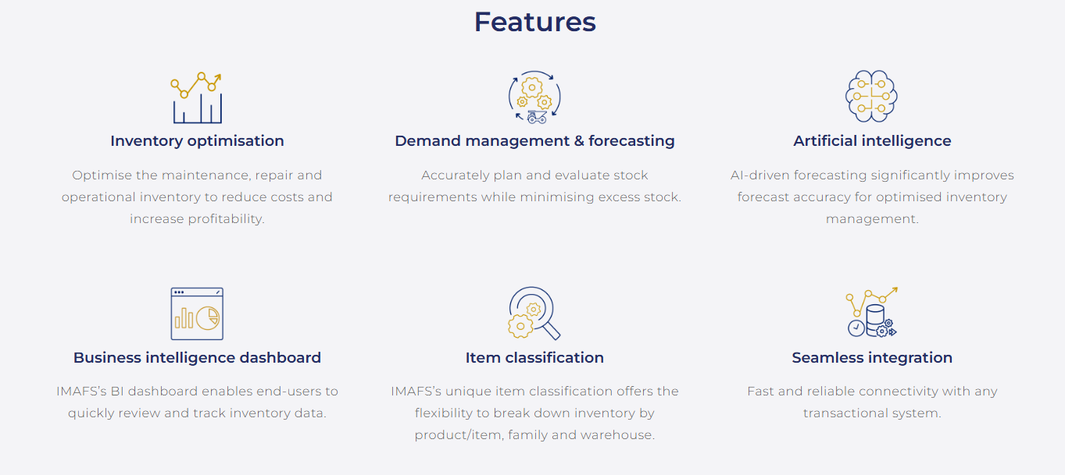
RPMGLOBAL
https://rpmglobal.com/product/imafs/
https://www.youtube.com/watch?v=sD8XGxMKiV4&t=62s
1- <number>

Slide 18
Independent Demand Inventory Models-I
Introduction
The average manufacturing company spends over one-half of its sales revenue on inventory. Because of the large investment and expenditure required for acquiring and controlling inventories and their effect on profits, successful companies devote a great deal of attention to inventory management.
How much inventory is enough?
- Marketing department wants large inventory, it does not
like stockouts.
- Finance department likes low inventory and high turnover
to minimize funds tied up in inventories; opportunity cost
of capital.
Introduction
1- <number>

Slide 19
Independent Demand Inventory Models-II
- Production department likes to keep production costs low. It likes uniform production and long uninterrupted runs of a small number of products.
Inventory models attempt to consider the cost of stockouts and
lost sales, the cost of funds tied up in inventories and the cost of
set-ups and to balance these cost as as to minimize the total
cost.
Introduction
1- <number>

Slide 20
Inventory Management-I
Inventory: An idle resource of any kind that has potential economic value
- raw materials
- component parts
- work-in-process
- finished products, etc.
Reasons for carrying inventory
1) To provide service
- finished good inventory to meet demand and keep
customers happy
- work-in-progress inventory to increase flexibility by
decoupling production stages and keep machines running
- raw material inventory keeps production moving
- protection against uncertainty
Introduction
1- <number>

Slide 21
Inventory Management-II
2) To save money
- buying in large quantities allows spreading of fixed costs
such as ordering costs and obtaining quantity discounts.
- stocking of seasonal items allow production smoothing or
work-load balancing.
“The aborigine knew nothing of inventory control, and, quite possibly his 20th century corporate counterpart is equally as unenlightened. The changeover from inventory to inventory control bears no date. Some concerns plunged into the healthful waters of scientific management of inventories well before the first world war. Others are still on the shore contemplating on the advisability of wetting their toes. (Benjamin Melnitsky).
Introduction
1- <number>

Slide 22
Inventory Management-III
History
1915 F.W.Harris (Westinghouse)
Lot size formula (EOQ model); independently
developed by Wilson and sold to many companies as
an integral part of an inventory control scheme.
1931 F.E. Raymond (MIT)
Wrote the first full length book.
WWII Christmas tree problem (Newsboy problem)
Whitin’s stochastic extension of the EOQ model.
Early Computer made it possible to handle large data
requirement
1950’s Of the inventory models, Whitin published a book on
stochastic inventory models in 1953.
Introduction
1- <number>

Slide 23
Inventory Management-IV
1958 Arrow, Karlin and Scarf published their now classical
book, which is a definitive work on inventory theory,
inspired a great deal of research for next decade.
Mid Material requirement planning (MRP)
1970’s Books by Orlicky, Wight in 1974
Introduction
1- <number>

Slide 24
Inventory Problem-I
Solve for
1) When should an order be placed?
2) How much should be ordered?
3) What should be ordered
in order to minimize the costs
Applications
- raw materials, intermediate products, finished goods
- capacity planning (e.g., hospital beds)
- cash management
Introduction
1- <number>

Slide 25
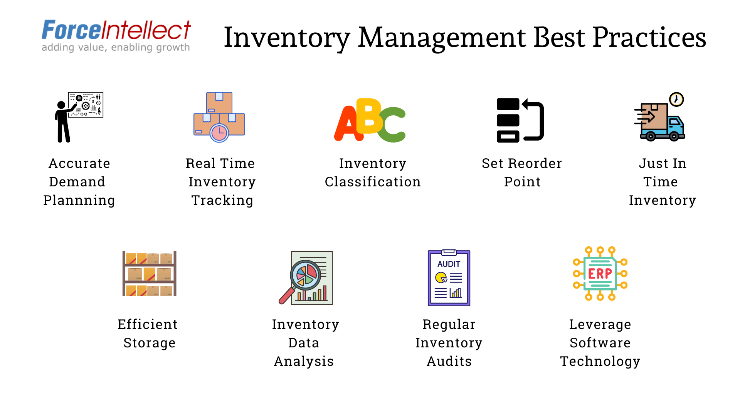

Introduction
1- <number>

Slide 26
Inventory Management Best Practices in Industry
Accurate Demand Planning:
Accurate demand planning is the foundation of efficient inventory management. Manufacturers must closely analyze production plan and forecast to determine the demand for their products accurately. By aligning production levels with anticipated demand, companies can minimize the risk of excess inventory or stockouts.
Introduction
1- <number>

Slide 27
Leverage Technology
Leveraging technology is crucial for efficient inventory management in the manufacturing industry. Use technology to streamline processes, reduce human errors, and improve overall efficiency. Integrated enterprise resource planning (ERP) systems provide end-to-end visibility, enabling seamless coordination between inventory, production, sales, and procurement functions.
Introduction
1- <number>

Slide 28
Regular Inventory Audits
Conducting regular inventory audits is essential to ensure accuracy and identify any discrepancies. Physical counts and reconciliations help verify the actual inventory levels and uncover any inconsistencies between recorded and actual stock quantities. Implementing cycle counting, where subsets of inventory are counted frequently throughout the year, reduces disruptions and minimizes the need for full-scale physical inventories.
Introduction
1- <number>

Slide 29
Inventory Data Analysis:
Regular analysis of inventory data can provide valuable insights into demand patterns, lead times, and overall inventory performance. By utilizing inventory management software and data analytics tools, manufacturers can identify trends, forecast demand accurately, and make data-driven decisions. Analyzing data on slow-moving or obsolete items helps identify potential liquidation or disposal opportunities, minimizing holding costs and maximizing profitability.
Introduction
1- <number>

Slide 30
Real-Time Inventory Tracking:
Real-time inventory tracking is essential to maintain an accurate picture of stock levels and prevent discrepancies. By utilizing inventory management systems and technologies, manufacturers can monitor inventory in real-time, enabling them to make informed decisions about replenishment, production schedules, and customer orders. This visibility improves order fulfilment rates and reduces the chances of stockouts or overstocking.
Introduction
1- <number>

Slide 31
Inventory Classification:
Classifying inventory based on its value, demand, and criticality can help manufacturers prioritize their stock management efforts. Adopting an ABC analysis, where items are classified into categories A, B, and C based on their stock value, allows companies to allocate resources effectively. High-value items (A category) should receive increased attention, while monitoring of low-value items (C category) can be delegated to junior o middle management
Introduction
1- <number>

Slide 32
just-in-time (JIT) inventory or KANBAN
Implementing a just-in-time (JIT) inventory approach enables manufacturers to minimize holding costs and optimize cash flow. By receiving materials and components from suppliers just in time for production, companies can reduce excess inventory levels and associated carrying costs. JIT inventory management requires close collaboration with suppliers to ensure reliable and timely deliveries, improving overall supply chain efficiency.
Introduction
1- <number>

Slide 33
Setting appropriate reorder points
Setting appropriate reorder points is vital to avoid stockouts and maintain optimal inventory levels. Reorder points are predetermined inventory thresholds that trigger the replenishment process. By calculating reorder points based on lead time, demand variability, and desired stock level, manufacturers can ensure timely restocking, minimizing the risk of stockouts and associated production delays.
Introduction
1- <number>

Slide 34
Optimizing storage
Optimizing storage space is crucial to minimize operational costs and maximize inventory turnover. Manufacturers should design their warehouses and storage facilities to utilize space efficiently, considering factors such as item size, weight, and turnover rate. Proper organization, labeling, and bin location systems facilitate easy identification and retrieval of items, reducing the time required for inventory handling.
Introduction
1- <number>

Slide 35
Inventory Problem-II
Types of inventory systems
- Order point planning (OPP)
- Fixed-Quantity system (Trans, 5-1)
- Fixed-Interval system (Trans, 5-2)
- Minimum-Maximum System, (s,S)-system
- Material requirement planning (MRP)
- Kanban or just-in-time system
Introduction
1- <number>

Slide 36
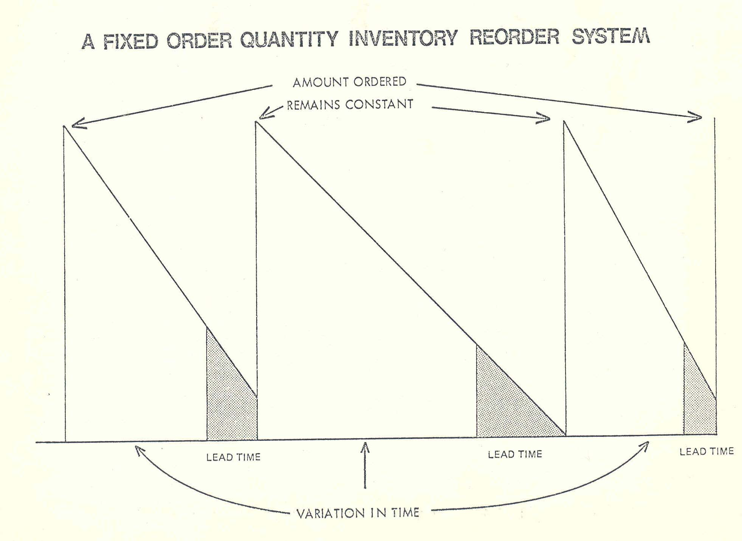
A Fixed Order Quantity Inventory Reorder System
Introduction
1- <number>

Slide 37
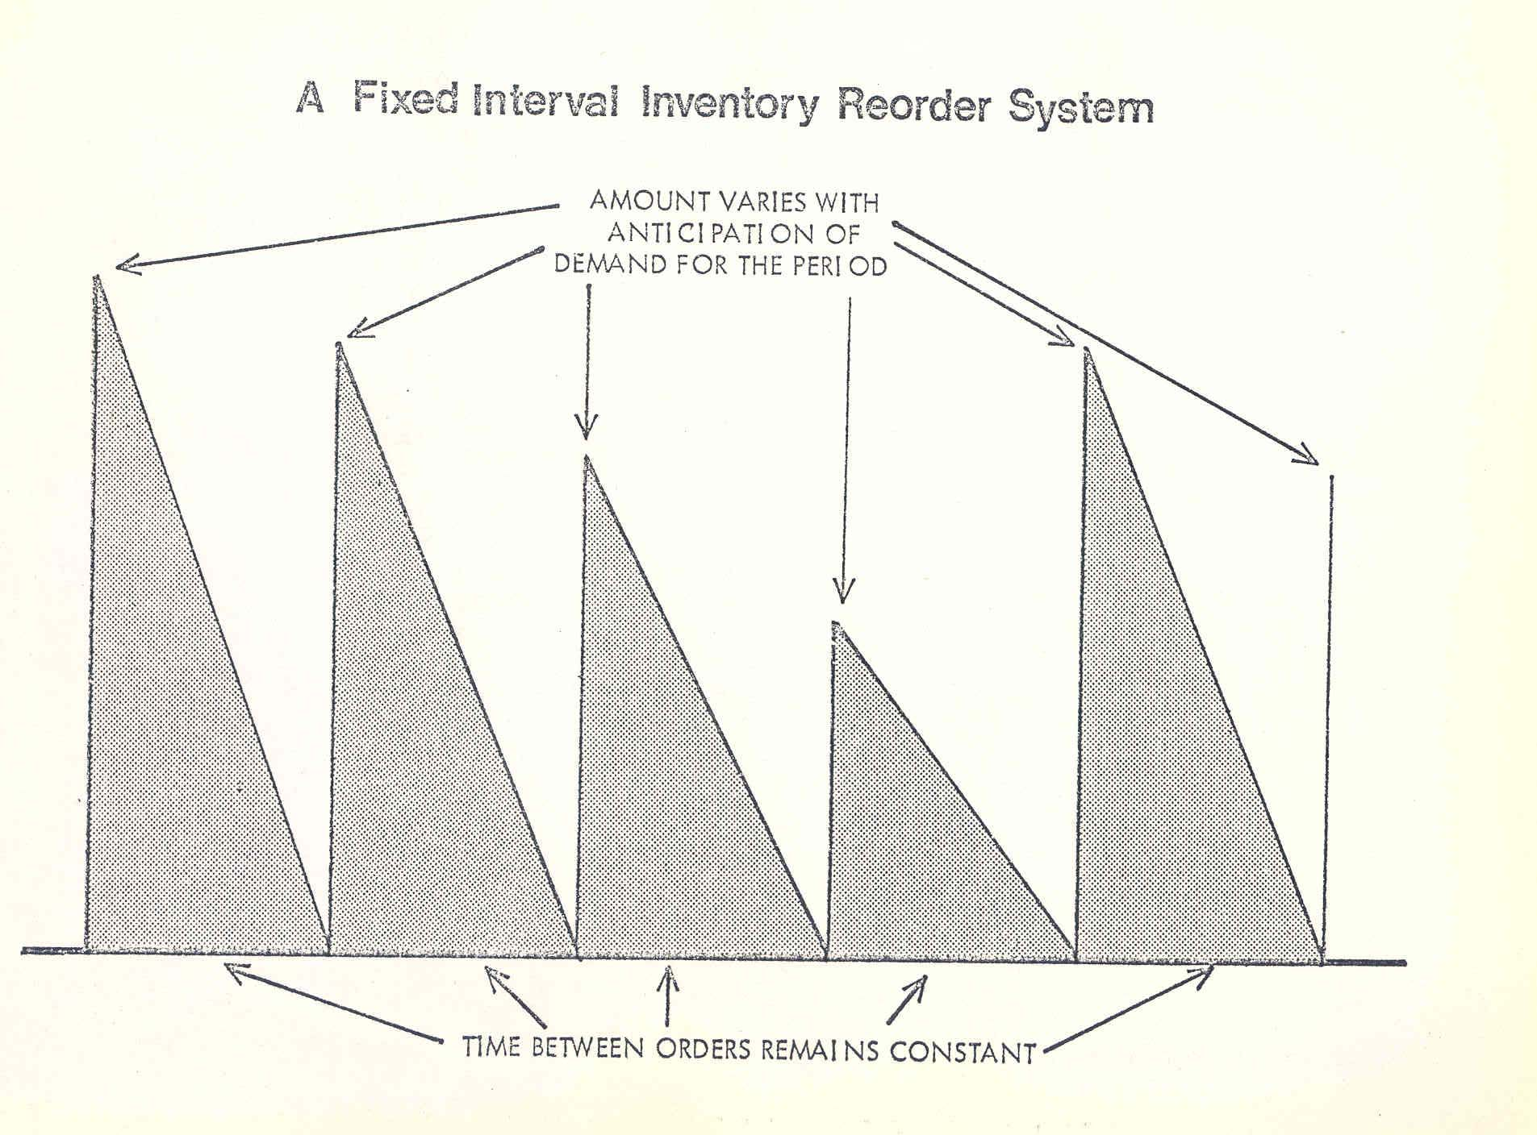
A Fixed Interval Inventory Reorder System
Introduction
1- <number>

Slide 38
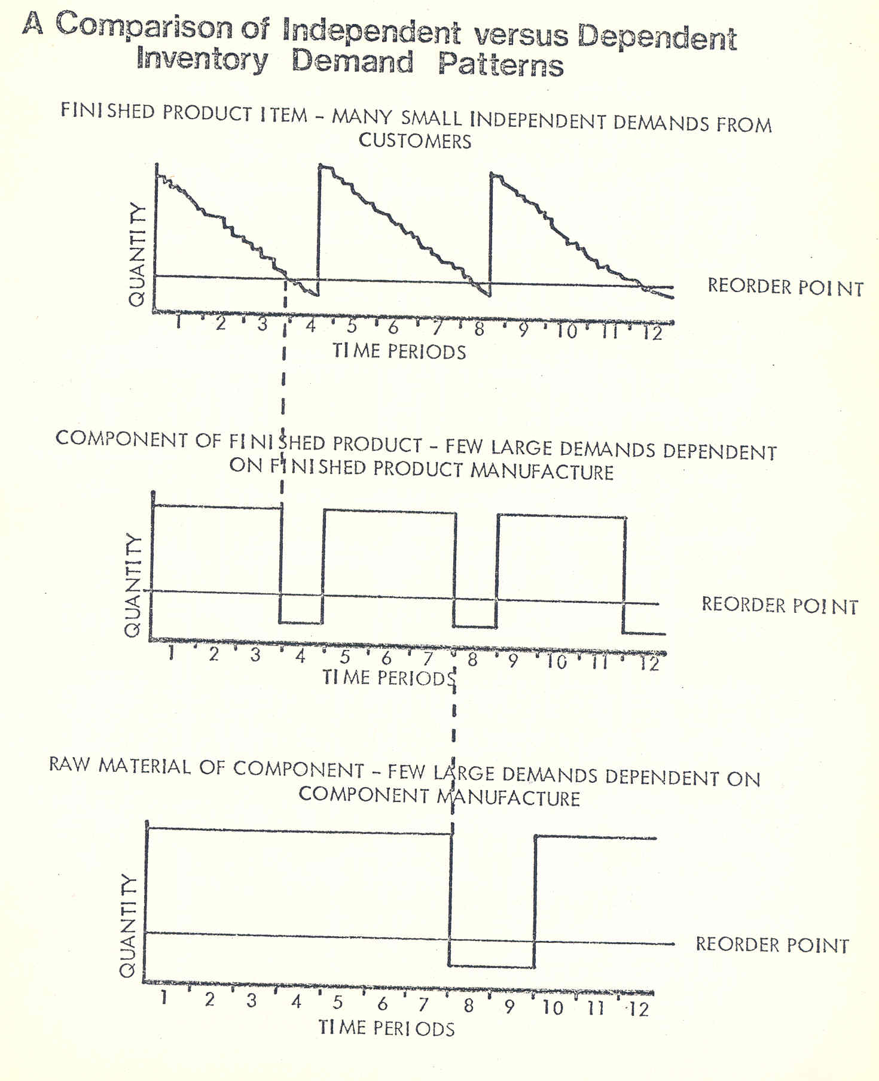
Introduction
1- <number>

Slide 39
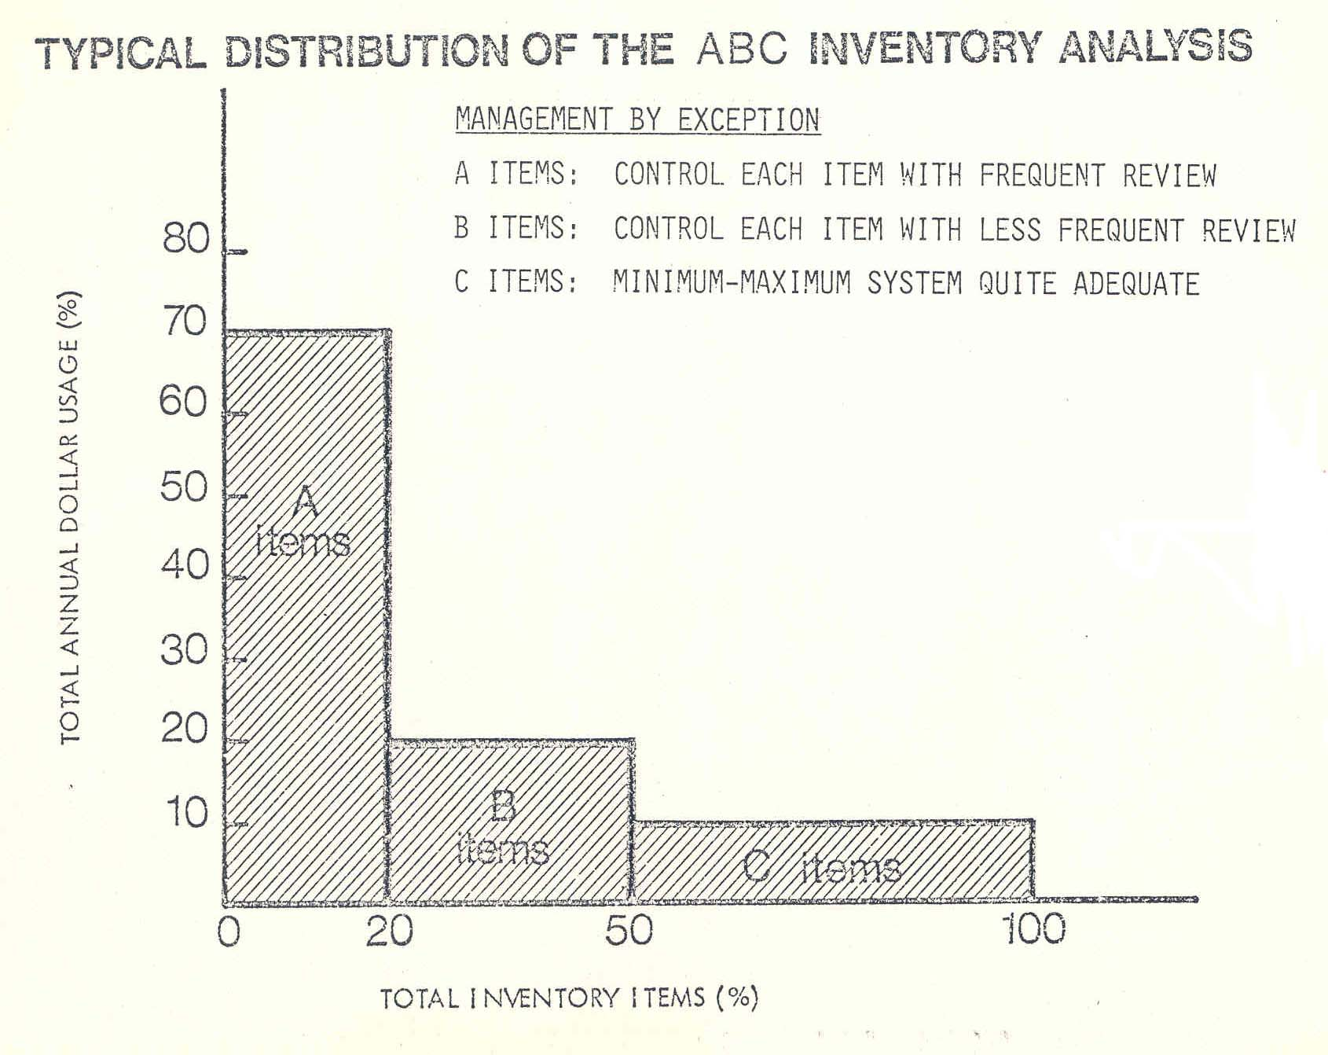
Typical Distribution of the ABC Inventory System
Introduction
1- <number>

Slide 40
General Framework for Inventory Models-I
Demand
- certainty
- risk, probability distribution of demand
- uncertainty, nothing known
Lead time: The period between the order time and the delivery time
- certainty
- risk, probability distribution of demand
- uncertainty
Inside or Outside Procurement
- purchased from outside; pure inventory problem
- integrated with production smoothing if inside
Introduction
1- <number>

Slide 41
General Framework for Inventory Models-II
Static and Dynamic Problems
- Static: one period problem, classic examples are
Christmas tree and newsboy problem
- Dynamic: decisions over time
Behavior of Demand through Time and for Various Items
- Stationary Demand: EOQ models
- Time-dependent Demand: WW model, Silver/Meal Heuristic
- Dependent Demand: MRP
Introduction
1- <number>

Slide 42
General Framework for Inventory Models-III
Costs
- Price or Variable Production Costs: quantity discounts
- Ordering or Setup Costs
- Holding or Inventory Carrying Costs
- Stockout/Shortage costs
Introduction
1- <number>

Slide 43
General Framework for Inventory Models-III
Information technology allows us to easily keep and update
information
Simple inventory system can include:
- forecasting module
- determination of order points and order quantities
- monitoring of inventory levels
Costs
- holding costs including opportunity costs
- ordering or setup costs
- shortage costs or service levels
Capacity Constraints
- demand distribution
- lead times
Will not consider speculative costs.
Introduction
1- <number>

Slide 44
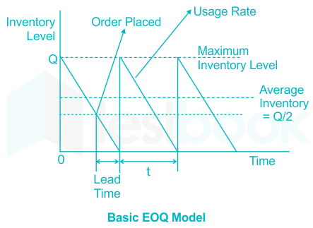
Introduction
1- <number>

Slide 45
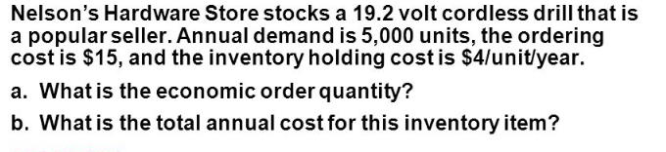
Introduction
1- <number>

Slide 46
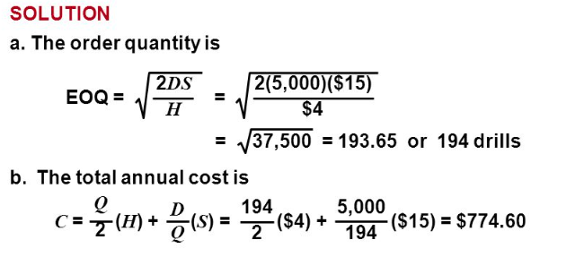
Introduction
1- <number>

Slide 47
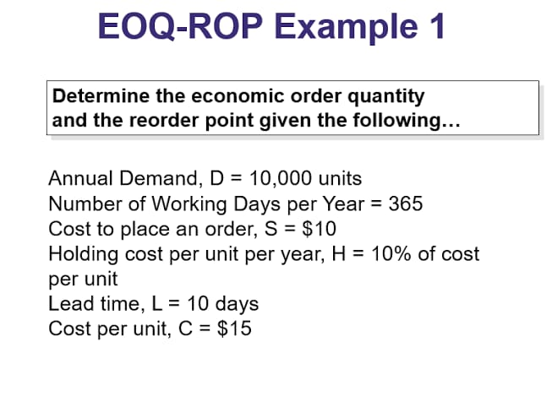
Introduction
1- <number>

Slide 48
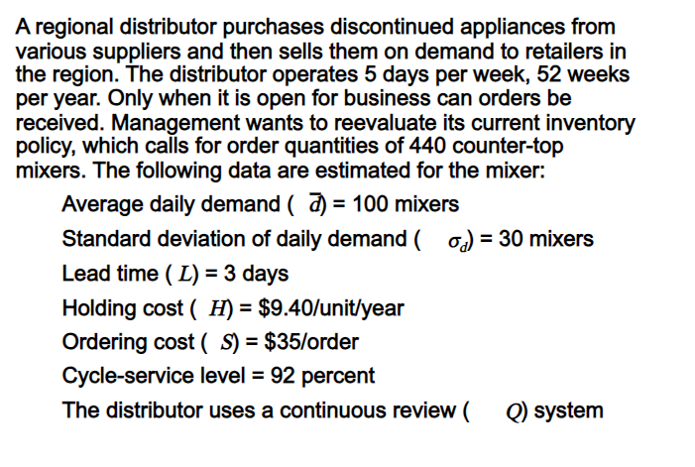
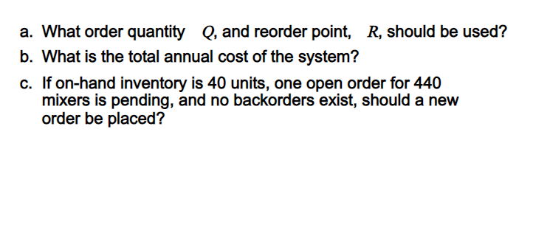
Introduction
1- <number>

Slide 49
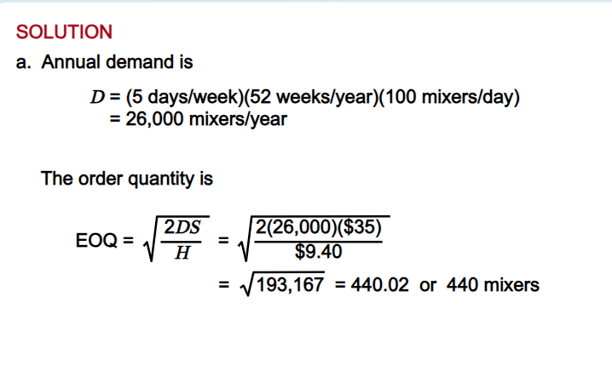
Introduction
1- <number>

Slide 50
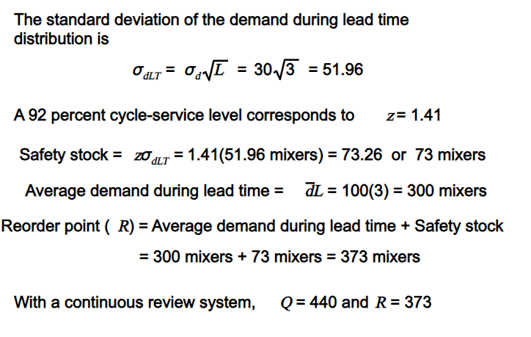
Introduction
1- <number>

Slide 51
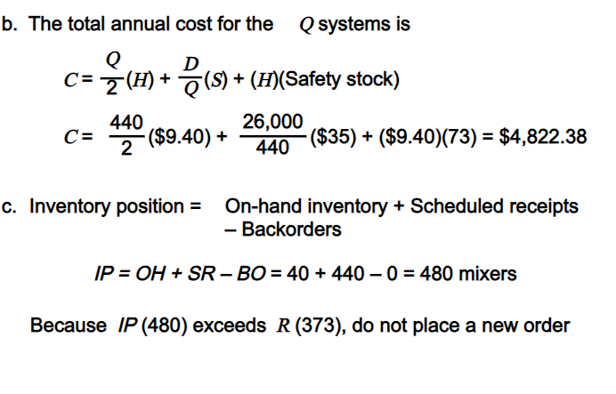
Introduction
1- <number>

